Slide 1

RNS Institute of Technology Department of Computer Science and Engineering Vision: Preparing better Computer Professional for a Real World V Semester Database Management System 18CS53
S Mamatha Jajur
Assistant Professor
CSE Department
RNSIT

Slide 2
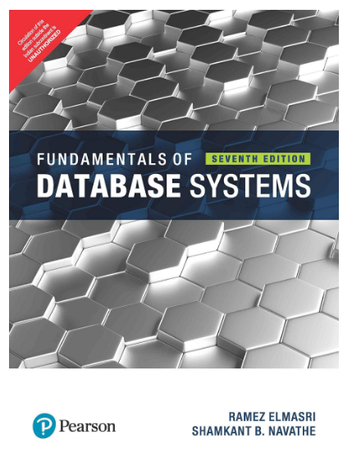
Text Books
Fundamentals of Database Systems, Ramez Elmasri and Shamkant B. Navathe, 7th Edition, 2017, Pearson.
Database management systems, Ramakrishnan, and Gehrke, 3rd Edition, 2014, McGraw Hill
Reference Books:
Silberschatz Korth and Sudharshan, Database System Concepts, 6th Edition, Mc- GrawHill, 2013.
Coronel, Morris, and Rob, Database Principles Fundamentals of Design, Implementation and Management, Cengage Learning 2012.

Slide 3
Module – 1
Introduction to Databases: Introduction, Characteristics of database approach, Advantages of using the DBMS approach, History of database applications. Overview of Database Languages and Architectures: Data Models, Schemas, and Instances. Three schema architecture and data independence, database languages, and interfaces, The Database System environment. Conceptual Data Modelling using Entities and Relationships: Entity types, Entity sets, attributes, roles, and structural constraints, Weak entity types, ER diagrams, examples, Specialization and Generalization.
Module – 2
Relational Model: Relational Model Concepts, Relational Model Constraints and relational database schemas, Update operations, transactions, and dealing with constraint violations. Relational Algebra: Unary and Binary relational operations, additional relational operations (aggregate, grouping, etc.) Examples of Queries in relational algebra. Mapping Conceptual Design into a Logical Design: Relational Database Design using ER-to-Relational mapping. SQL: SQL data definition and data types, specifying constraints in SQL, retrieval queries in SQL, INSERT, DELETE, and UPDATE statements in SQL, Additional features of SQL.

Slide 4
Module – 3
SQL : Advances Queries: More complex SQL retrieval queries, Specifying constraints as assertions and action triggers, Views in SQL, Schema change statements in SQL. Database Application Development: Accessing databases from applications, An introduction to JDBC, JDBC classes and interfaces, SQLJ, Stored procedures, Case study: The internet Bookshop. Internet Applications: The three-Tier application architecture, The presentation layer, The Middle Tier
Module – 4
Normalization: Database Design Theory – Introduction to Normalization using Functional and Multivalued Dependencies: Informal design guidelines for relation schema, Functional Dependencies, Normal Forms based on PrimaryKeys, Second and Third Normal Forms, Boyce-Codd Normal Form, Multivalued Dependency and Fourth Normal Form, Join Dependencies and Fifth Normal Form. Normalization Algorithms: Inference Rules, Equivalence, and Minimal Cover, Properties of Relational Decompositions, Algorithms for Relational Database Schema Design, Nulls, Dangling tuples, and alternate Relational Designs, Further discussion of Multivalued dependencies and 4NF, Other dependencies and Normal Forms

Slide 5
Module – 5
Transaction Processing: Introduction to Transaction Processing, Transaction and System concepts, Desirable properties of Transactions, Characterizing schedules based on recoverability, Characterizing schedules based on Serializability, Transaction support in SQL. Concurrency Control in Databases: Two-phase locking techniques for Concurrency control, Concurrency control based on Timestamp ordering, Multiversion Concurrency control techniques, Validation Concurrency control techniques, Granularity of Data items and Multiple Granularity Locking.
Introduction to Database Recovery Protocols: Recovery Concepts, NO-UNDO/REDO recovery based on Deferred update, Recovery techniques based on immediate update, Shadow paging, Database backup and recovery from catastrophic failures

Slide 6
Introduction to Databases and Data Modeling Concepts

Slide 7
Contents
Introduction to Data, Database, DBMS, Database System
Why Use Databases ? Advantages of Database Approach
Database Users – End Users, DBA
Data Models – Conceptual, Representational, Physical
Database Architectures – Centralized, 2-tier, 3-tier
Database Design Phases
Three Level Schema - Data Independence
ER Model – ER Schema
Relational Data Model – Relational Schema

Slide 8
Databases and database systems are an essential component of life in modern society: most of us encounter several activities every day that involve some interaction with a database.
Databases and database technology have had a major impact on the growing use of computers. It is fair to say that databases play a critical role in almost all areas where computers are used, including business, electronic commerce, social media, engineering, medicine, genetics, law, education, and library science.
A database represents some aspect of the real world, sometimes called the miniworld or the universe of discourse (UoD). Changes to the miniworld are reflected in the database.

Slide 9
A database is a logically coherent collection of data with some inherent meaning. A random assortment of data cannot correctly be referred to as a database.
A database is designed, built, and populated with data for a specific purpose. It has an intended group of users and some preconceived applications in which these users are interested.

Slide 10
Database:
A collection of related data/ information.
Data:
Known facts that can be recorded and have an implicit meaning.
Mini-world or Universe of discourse(UoD):
Some part of the real world about which data is stored in a database. For example, student grades and transcripts at a university.
Database Management System (DBMS):
A collection of programs that enables users to create and maintain database.
Database System:
The DBMS software together with the database. Sometimes, the applications are also included.

Slide 11
A database management system (DBMS) is a computerized system that enables users to create and maintain a database.
The DBMS is a general-purpose software system that facilitates the processes of defining, constructing, manipulating, and sharing databases among various users and applications.
Defining a database involves specifying the data types, structures, and constraints of the data to be stored in the database. The database definition or descriptive information is also stored by the DBMS in the form of a database catalog or dictionary; it is called meta-data.
Constructing the database is the process of storing the data on some storage medium that is controlled by the DBMS.
Manipulating a database includes functions such as querying the database to retrieve specific data, updating the database to reflect changes in the miniworld, and generating reports from the data.
Sharing a database allows multiple users and programs to access the database simultaneously

Slide 12
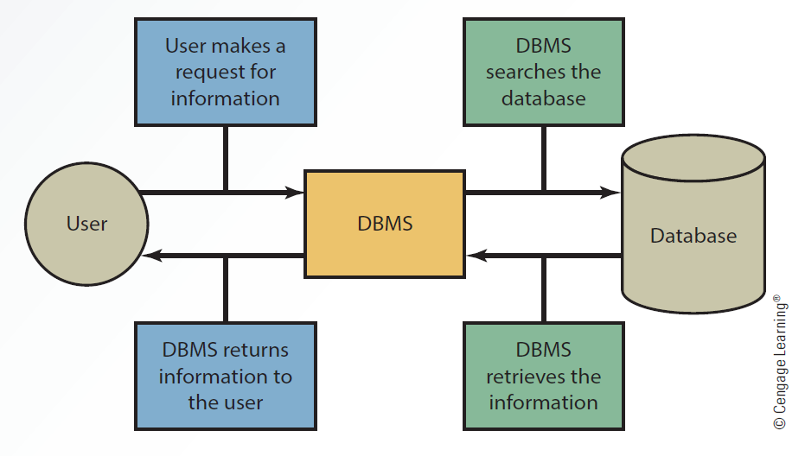
Interaction Between the User, DBMS and Database

Slide 13
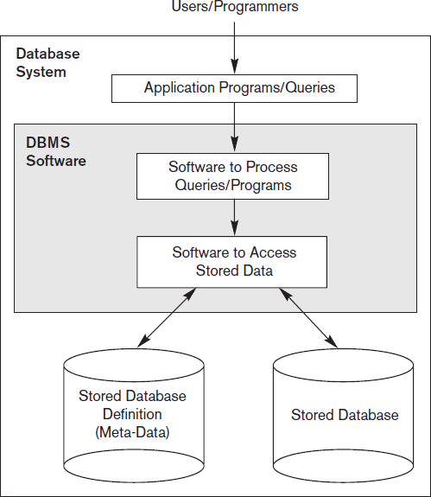

Slide 14
Types of databases
There are many different types of databases. The best database for a specific organization depends on how the organization intends to use the data.
Hierarchical Databases.
Network Databases.
Relational Database.
Object-oriented Databases.
Centralized Database.
Distributed Database.
NoSQL Database.
Cloud Database.

Slide 15
Database Applications
Banking: Customers , Accounts, all transactions
Airlines: reservations, schedules
Railways: reservations, schedules
Stock Exchange: Customers, Shares
Universities: registration, grades
Sales: customers, products, purchases
Online retailers: order tracking, customized recommendations
Manufacturing: production, inventory, orders, supply chain
Human resources: employee records, salaries, tax deductions
Insurance Agencies: Customers, Policies, Schemes

Slide 16
Popular DBMSs
MySQL (open-source)
Microsoft Access (Microsoft)
Microsoft SQL Server (Microsoft)
Oracle Database (Oracle, relational database )
SQLite (open-source)
PostgreSQL (open source object-relational database system )
MongoDB (NoSQL)
MariaDB (open source relational database )
Firebase (Google, NoSQL)
CouchDB, CouchBase, Cassandra, HBase, Redis, Riak, Neo4J (NoSQL)

Slide 17
Database Systems
In the early days, database applications were built directly on top of file systems
Drawbacks of using file systems to store data:
Data redundancy and inconsistency
Multiple file formats, duplication of information in different files
Difficulty in accessing data
Need to write a new program to carry out each new task
Data isolation — multiple files and formats
Integrity problems
Hard to add new constraints or change existing ones

Slide 18
Database Systems (contd..)
Atomicity of updates
Failures may leave database in an inconsistent state with partial updates carried out
Example: Transfer of funds from one account to another should either complete or not happen at all
Concurrent access by multiple users
Concurrent accesses needed for performance
Uncontrolled concurrent accesses can lead to inconsistencies
Example: Two people reading a balance and updating it at the same time
Security problems
Hard to provide user access to some, but not all, data

Slide 19
Example of a Database (with a Conceptual Data Model)
Mini-world for the example:
Part of a UNIVERSITY environment.
Some mini-world entities:
STUDENTs
COURSEs
SECTIONs (of COURSEs)
(academic) DEPARTMENTs
INSTRUCTORs
Some mini-world relationships:
SECTIONs are of specific COURSEs
STUDENTs take SECTIONs
COURSEs have prerequisite COURSEs
INSTRUCTORs teach SECTIONs
COURSEs are offered by DEPARTMENTs
STUDENTs major in DEPARTMENTs
Note: The above entities and relationships are typically expressed in a conceptual data model, such as the ENTITY-RELATIONSHIP data model (see Chapters 3, 4)

Slide 20
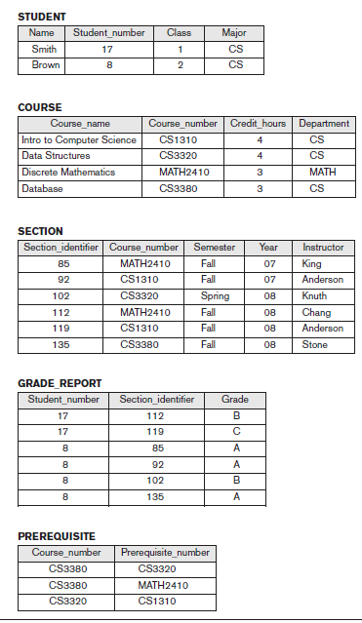
Example of a simple database

Slide 21
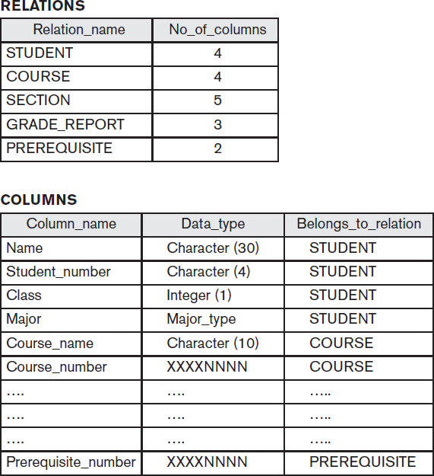
Main Characteristics of the Database Approach
Self-describing nature of a database system:
A DBMS catalog stores the description of the database. The description is called meta-data. This allows the DBMS software to work with different databases.

Slide 22
Insulation between programs and data:
Program – data independence
Allows changing data storage structures and operations without having to change the DBMS access programs.
🞑Program – operation independence
User application programs can operate on the data by invoking operations through their names and parameters regardless how operations are implemented.
🞑Data Abstraction:
The characteristics that allows program – data independence and program – operation independence is called data abstraction.
A data model is used to hide storage details and present the users with a conceptual view of the database.

Slide 23
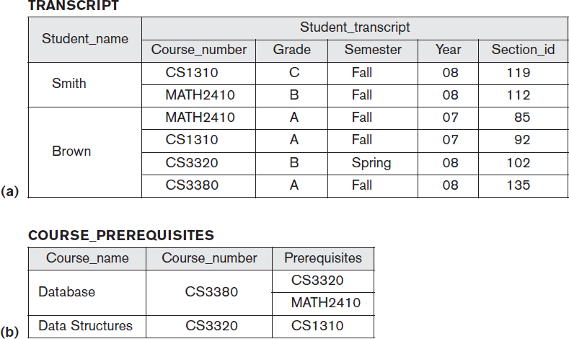
Main Characteristics of the Database Approach
Support of multiple views of the data:
Each user may see a different view of the database, which describes
only the data of interest to that user.

Slide 24
Sharing of data and multiuser transaction processing :
Allowing a set of concurrent users to retrieve and to update the database.
Concurrency control within the DBMS guarantees that each transaction is correctly executed or completely aborted.

Slide 25
Database Users
Users may be divided into those who actually use and control the content (called “Actors on the Scene”) and those who enable the database to be developed and the DBMS software to be designed and implemented (called “Workers Behind the Scene”).

Slide 26
Database Users
Actors on the scene
Database administrators
responsible for authorizing access to the database, for co – ordinating and monitoring its use, acquiring software, and hardware resources, controlling its use and monitoring efficiency of operations.
Database Designers
responsible to define the content, the structure, the constraints, and functions or transactions against the database. They must communicate with the end-users and understand their needs.
End-users
they use the data for queries, reports and some of them actually update the database content.
System Analysts and Application Programmers(Software Engineers)
System Analyst determine the requirements of end users, especially Naïve and parametric end users and develop specifications for canned transactions that meet these requirements.
Application Programmers implement these specifications as programs, then they test, debug, document and maintain these canned transactions.

Slide 27
Database Administrator (DBA)
Coordinates all the activities of the database system
has good understanding of the enterprise’s information resources and needs.
Responsible for Managing the resources
Database (primary)
DBMS (secondary)
DBA's duties include:
Storage structure and access method definition
Schema and physical organization modification
Granting users authority to access the database
Backing up data
Monitoring performance and responding to changes in requirements
Database tuning

Slide 28
End Users
Casual Users
uses a sophisticated database query language to specify their requests and are typically middle or high level managers
Sophisticated Users
form requests in a database query language. Scientists/Engineers
Specialized Users
write specialized database applications that do not fit into the traditional data processing framework
Naïve or Parametric Users
invoke one of the permanent application programs that have been written previously. Example: people accessing database over the web, bank tellers, clerical staff
Standalone Users
who maintain personal databases by using ready made program packages that provide easy to use menu or GUI based interfaces

Slide 29
Database Users
Workers behind the scene
🞑 DBMS System Designers and Implementers
🞑 Tool Developers
🞑 Operators and Maintenance Personnel

Slide 30
Advantages of Using the Database Approach
Controlling Redundancy
Restricting Unauthorized Access
Providing Persistent Storage for Program Objects
Providing backup and recovery services.
Providing multiple interfaces to different classes of users.
Representing complex relationships among data.
Enforcing integrity constraints on the database.
Permitting Inferencing and Actions using rules

Slide 31
Additional Implications of Using the Database Approach
Potential for enforcing standards:
This is very crucial for the success of database applications in large organizations Standards refer to data item names, display formats, screens, report structures, meta-data (description of data) etc.
Reduced application development time:
Incremental time to add each new application is reduced.
Flexibility to change data structures:
Database structure may evolve as new requirements are defined.
Availability of up-to-date information:
Very important for on-line transaction systems such as airline, hotel, car reservations.
Economies of scale:
By consolidating data and applications across departments wasteful overlap of resources and personnel can be avoided.

Slide 32
Brief History of Database Applications
Early Database Applications: The Hierarchical and Network Models were introduced in mid 1960’s and dominated during the seventies. A bulk of the worldwide database processing still occurs using these models.
Relational Model based Systems: The model that was originally introduced in 1970 was heavily researched and experimented with in IBM and the universities. Relational DBMS Products emerged in the 1980’s.

Slide 33
Historical Development of Database Technology
Object-oriented applications: OODBMSs were introduced in late 1980’s and early 1990’s to cater to the need of complex data processing in CAD and other applications. Their use has not taken off much.
Data on the Web and E-commerce Applications: Web contains data in HTML (Hypertext markup language) with links among pages. This has given rise to a new set of applications and E- commerce is using new standards like XML (eXtended Markup Language).

Slide 34
When not to use a DBMS
The overhead costs of using a DBMS:
High initial investment in hardware, software and training.
The generality that a DBMS provides for defining and processing of data.
Overhead for providing security, concurrency control, recovery, and integrity functions.
When a DBMS may be unnecessary:
If the database and applications are simple, well defined, and not expected to change.
If there are stringent real-time requirements that may not be met because of DBMS overhead.
Embedded systems with limited storage capacity, where a general purpose DBMS would not fit.
If access to data by multiple users is not required.
When no DBMS may suffice:
If the database system is not able to handle the complexity of data because of modeling limitations
If the database users need special operations not supported by the DBMS.

Slide 35
Overview of Database Languages and Architectures

Slide 36
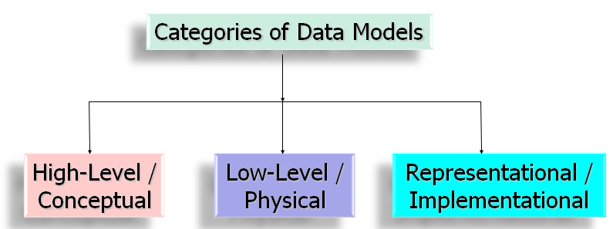
Data Models
Data Model: A set of concepts to describe the structure of a database, and certain constraints that the database should obey.
By structure, we mean the data types, relationships, and constraints that should hold for the data
Data Model Operations: Operations for specifying database retrievals and updates by referring to the concepts of the data model. Operations on the data model may include basic operations and user-defined operations.

Slide 37
Categories of data models
Conceptual (high-level, semantic) data models
🞑 Provide concepts that are close to the way many users perceive data. (Also
called entity-based or object-based data models.)
Physical (low-level, internal) data models
🞑 Provide concepts that describe details of how data is stored in the computer.
Implementation (representational) data models
🞑 Provide concepts that fall between the above two, balancing user views with
some computer storage details.

Slide 38
Categories
High level / Conceptual data model: from the user perspective
For end user/customer
Entity, attribute, relationships
Entity –Relationship models
Low level: how data stored in computer
For computer specialists/DBMS implementer
Physical data model
Record formats, record orderings, access paths
Representational (implementation) model
Meant for end user
With some of the data organizational information
Can be implemented directly in a computer
E.g. Relational data model
Network data model
Hierarchical data model

Slide 39
Types of Representational (Implementational) Database Models
HIERARCHICAL
NETWORK
Integrated Data Store (IDS) by GE (1960s) (Honeywell Info Systems)
Information Management System (IMS) from IBM (1966)
COLUMN
RELATIONAL
ROW
VALUE
TABLE
Oracle, Sybase, MySQL
Notes:
The most well-known record-based models are the relational model, the network model and the hierarchical model.
Relational model: In this model, each database item is viewed as a record with attributes. A set of records with similar attributes is called a table. Most of the popular commercial DBMS products like Oracle, Sybase, MySQL, etc. are based on the relational model.
Network model: represents data as record types. However, unlike the relational model, here we have explicit linkages (expressed in the form of pointers) which relate various records. Each record has a link field corresponding to every relationship which it participates in. IDS (Integrated Data Store) is one of the DBMS product based on network models.
Hierarchical Model: represents data as hierarchical tree. This is a special kind of a network model in which the relationship is essentially a tree-like structure, where one parent may have many children but one child can not have more than one parent. The relationship borrower to books in a library system satisfies this condition. One of the popular DBMS based on hierarchical model is Information Management System (IMS) from IBM.
Object Oriented model: represents DB in terms of objects, their attributes, and their behaviors.

Slide 40
Schemas, Instances and Database State
Database Schema
🞑 The description of a database. Includes descriptions of the database structure and the constraints that should hold on the database.
Schema Diagram
🞑 A diagrammatic display of (some aspects of) a database schema.
Schema Construct
🞑 A component of the schema or an object within the schema, e.g., STUDENT, COURSE.
Database State
🞑 The actual data stored in a database at a particular moment in time. Also called snapshot or instance or occurrence.

Slide 41
Database Schema Vs. Database State
Initial Database State
🞑 Refers to the database when it is loaded
Valid State
🞑 A state that satisfies the structure and constraints of the database.
🞑 The database schema changes very infrequently. The database state changes every time the database is updated.
Schema is also called intension, whereas state is called extension.

Slide 42
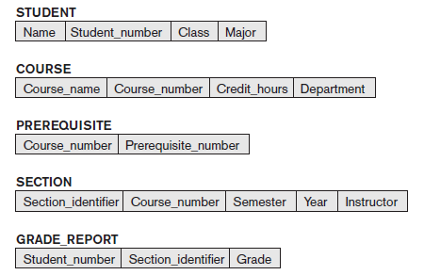
Database Schema

Slide 44
What is Database Schema?
A description of the database (meta-data)
Covers only some aspects
E.g. name of record type, data items, some constraints
Not changed frequently
Specify when a new database defined
Meta-data = DBMS Catalog
Schema constructs: Objects in schema
Schema diagram
Convention to display schema

Slide 45
Database Instances
Data in the database at a particular time
Database state (Extension OR Database snapshot)
It is the actual data stored in a database at a particular moment in time. This includes the collection of all the data in the database.
The term instance is also applied to individual database components, e.g. record instance, table instance, entity instance.
Instance
= snapshot
= database state
~= current set of occurrences
DB Schema = intention of the database
DB state = extension of the Schema

Slide 46
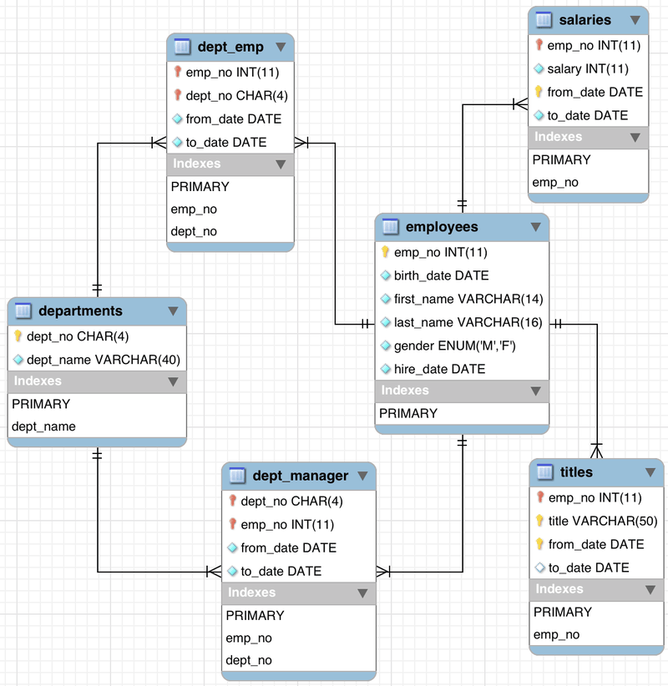

Slide 47
Metadata
DBMS definition is stored in DBMS catalog, which contains information such as structure of each file, type, storage format of each data item and various constraints on data.
This information stored in the catalog is called as metadata and it describes the structure of the primary database.
Metadata is by definition "data about other data".

Slide 48
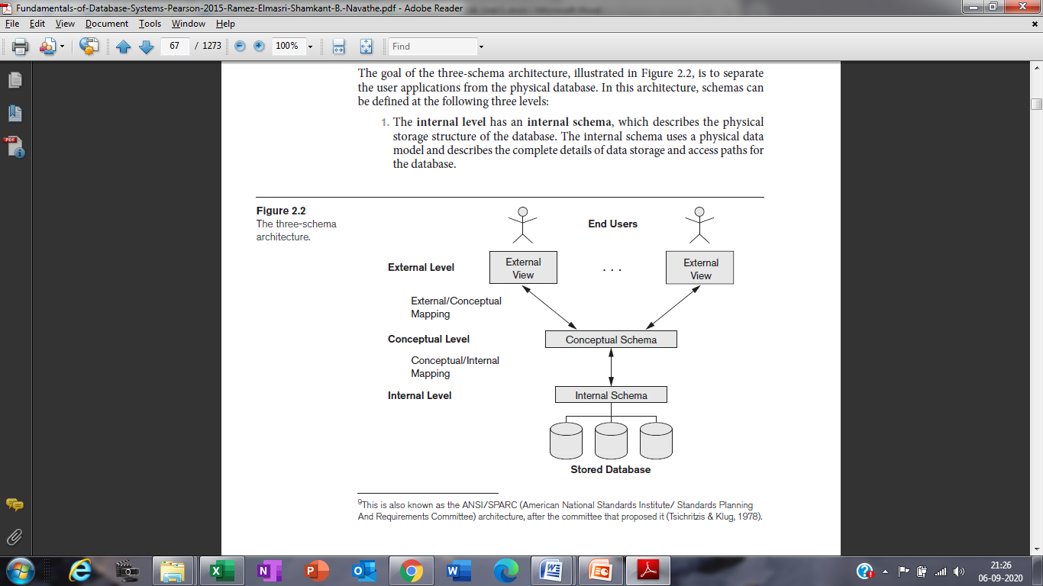
Three schema Architecture of database system
1. Internal schema
It uses the physical data model.
Describes the physical storage of the data.
Also provides information about the access paths (Ex: indexes)

Slide 49
2. Conceptual schema
It uses the representational data model.
Describes the structure of the database for users.
Hides the details of the physical storage structure.
Details about entities, relationships, data types, constraints etc…

Slide 50
3. External schemas
Describes the database for a particular user group.
The rest of the database is hidden from that user group.
Usually uses the same data model as the conceptual schema.

Slide 51
Data Independence
The schema at one level can be changed without having to change the schema at the next higher level.
Two types of data independence
Logical Data Independence
Physical Data Independence

Slide 52
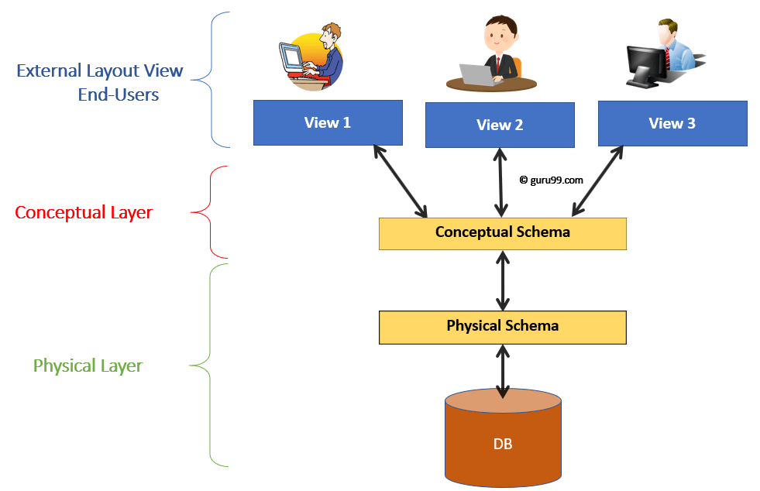
Logical Data Independence:
The capacity to change the conceptual schema without having to change the external schemas and their associated application programs.
Examples
Add/Modify/Delete a new attribute without a rewrite of existing application programs
Merging two records into one, Breaking an existing record into two or more records

Slide 53
Physical Data Independence:
The capacity to change the internal schema without having to change the conceptual schema.
Examples
Using a new storage device like Hard Drive or Magnetic Tapes
Switching to different data structures.
Change of Location of Database from say C drive to D Drive

Slide 54
Database Languages and Interfaces
Data Definition Language (DDL)
It is used by the DBA and database designers to specify the conceptual schema of a database.
In many DBMSs, the DDL is also used to define internal and external schemas (views).
In some DBMSs, separate storage definition language (SDL) and view definition language (VDL) are used to define internal and external schemas.
Examples : CREATE, ALTER, DROP commands in SQL

Slide 55
Data Manipulation Language (DML)
It is used to specify database retrievals and updates.
DML commands (data sublanguage) can be embedded in a general-purpose programming language such as COBOL, C, C++, or Java.
A library of functions can also be provided to access the DBMS from a programming language.
Examples : INSERT, SELECT, UPDATE, DELETE commands in SQL
Data Control Language (DCL)
It is used to assign roles, permission and referential integrity.
Examples: GRANT, REVOKE

Slide 56
Storage Definition Language (SDL)
Used to specify internal schema
View Definition Language (VDL)
Used to define internal and external schemas.

Slide 57
DBMS Interfaces
Menu-based Interfaces for Web Clients or Browsing
Apps for Mobile Devices
Forms-based Interfaces
Graphical User Interfaces
Natural Language Interfaces
Keyword-based Database Search
Speech Input and Output
Interfaces for Parametric Users
Interfaces for the DBA

Slide 58
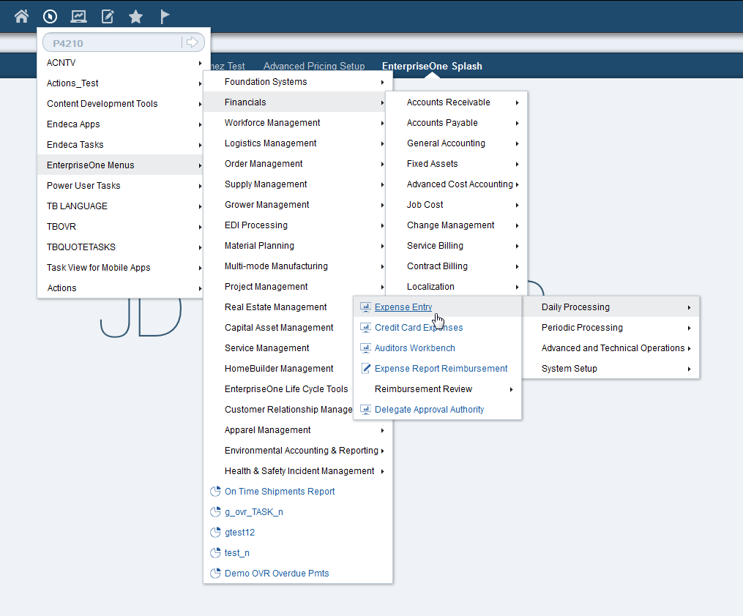
Menu-based Interfaces for Web Clients or Browsing
Menus lead the user through the formulation of a request.
Pull-down menus are a very popular technique in Web-based user interfaces.
Often used in browsing interfaces.

Slide 59
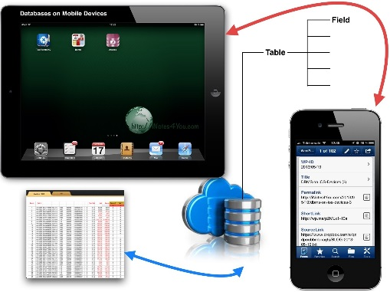
Apps for Mobile Devices
Banking, reservations, insurance companies.
The apps have built-in programmed interfaces that allow users to login using their account name and password
Apps provide a limited menu of options for mobile access to the user data, as well as options such as paying bills (for banks) or making reservations (for reservation Web sites).

Slide 60
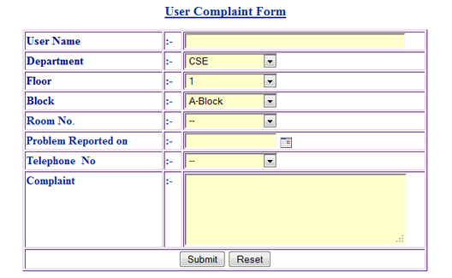
Forms-based Interfaces
Displays a form to each user.
Users can fill out all of the form entries to insert new data, or they can fill out only certain entries
Forms are usually designed and programmed for naive users as interfaces to canned transactions.

Slide 61
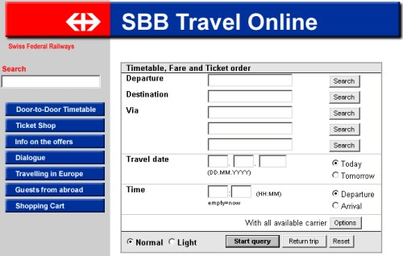
Graphical User Interfaces
A GUI typically displays a schema to the user in diagrammatic form.
The user then can specify a query by manipulating the diagram.
In many cases, GUIs utilize both menus and forms.

Slide 62
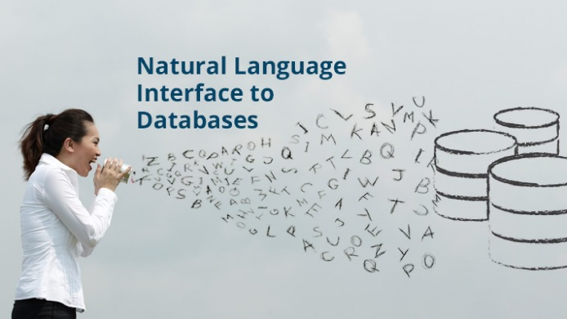
Natural Language Interfaces
Accept requests written in English or some other language and attempt to understand them.
Has its own schema, which is similar to the database conceptual schema.
If the interpretation is successful, the interface generates a high-level query corresponding to the natural language request and submits it to the DBMS for processing; otherwise, a dialogue is started with the user to clarify the request.

Slide 63
Keyword-based Database Search
Similar to Web search engines, which accept strings of natural language words and match them with documents at specific sites or Web pages.
They use predefined indexes on words and use ranking functions to retrieve and present resulting documents in a decreasing degree of match.
Speech Input and Output
Applications with limited vocabularies, such as inquiries for telephone directory, flight arrival/departure, and credit card account information, are allowing speech for input and output to enable customers to access this information.
The speech input is detected using a library of predefined words and used to set up the parameters that are supplied to the queries.
For output, a similar conversion from text or numbers into speech takes place.

Slide 64
Interfaces for Parametric Users
Parametric users, such as bank tellers, often have a small set of operations that they must perform repeatedly.
For example, a teller is able to use single function keys to invoke routine and repetitive transactions such as account deposits or withdrawals, or balance inquiries.
Interfaces for the DBA
Most database systems contain privileged commands that can be used only by the DBA staff.
These include commands for creating accounts, setting system parameters, granting account authorization, changing a schema, and reorganizing the storage structures of a database.

Slide 65
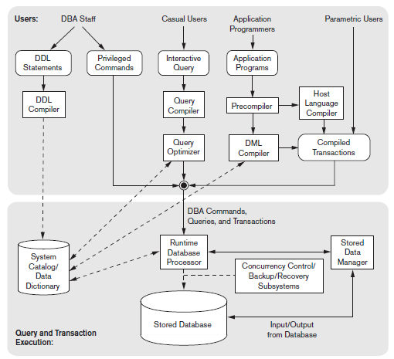
Component Modules of a DBMS

Slide 66
Component modules of a DBMS
The DBA staff works on defining the database and turning it by making changes to its definition using DDL and privileged commands.
DDL compiler processes schema definitions and store description of schema in DBMS catalog.
Catalog includes information such as name, size of file, data type, storage detail of each file, mapping information, constraints and many other information needed by DBMS modules.

Slide 67
Component modules of a DBMS
Casual users interact using some form of interface shown as interactive query interface.
These queries are parsed, analyzed for correctness of the operations by a query compiler that compiles them into an internal form.
This internal query is submitted to query optimizer.
Query optimizer obtains an optimized plan for executing the query. It generates executable code and makes call to the runtime processor.

Slide 68
Component modules of a DBMS
Application programmers write program in host language such as Java, C++ or C and are submitted to a precompiler.
Precompiler extracts DML commands from host language and sends them to DML compiler for compilation into object code.
Host language compiler generates object code. Then both object codes are lined to form a Canned Transaction.
These canned transactions are useful to parametric users who supply parameters to these canned transactions so that they can be run repeatedly as separate transaction.

Slide 69
Component modules of a DBMS
Runtime database processor executes privileged commands, executable query plans and canned transactions with runtime parameters. It works with system dictionary and update it.
Stored data manager module of the DBMS controls access to DBMS information that is stored on disk. It handles data transfer also.
Concurrency control, backup and recovery system are integrated into the working of the run time database processor for the purpose of transaction management.

Slide 70
Database System Utilities
They help the DBA to manage the database system. The functions of utilities are
Loading utility
Backup utility
Database storage reorganization utility
Performance monitoring utility

Slide 71
Loading utility
It is used to load existing data files such as text files or sequential files into the database.
Usually the source format of the data file and the target database file structure are specified to the utility, which then automatically reformats the data and stored it into the database.
The tool used for this purpose is called conversion tool.
Backup utility
It creates a backup copy of the database, usually by dumping the entire database onto tape.
The backup copy can be used to restore the database in case of catastrophic failure.

Slide 72
Database storage reorganization utility
It is used to reorganize a set of database files into a different file organization to improve performance.
Performance monitoring utility
It monitors usage and provides statistics to the DBA. The DBA uses these statistics in making decisions such as whether to recognize files or not to improve performance.

